Slide 1


Slide 2
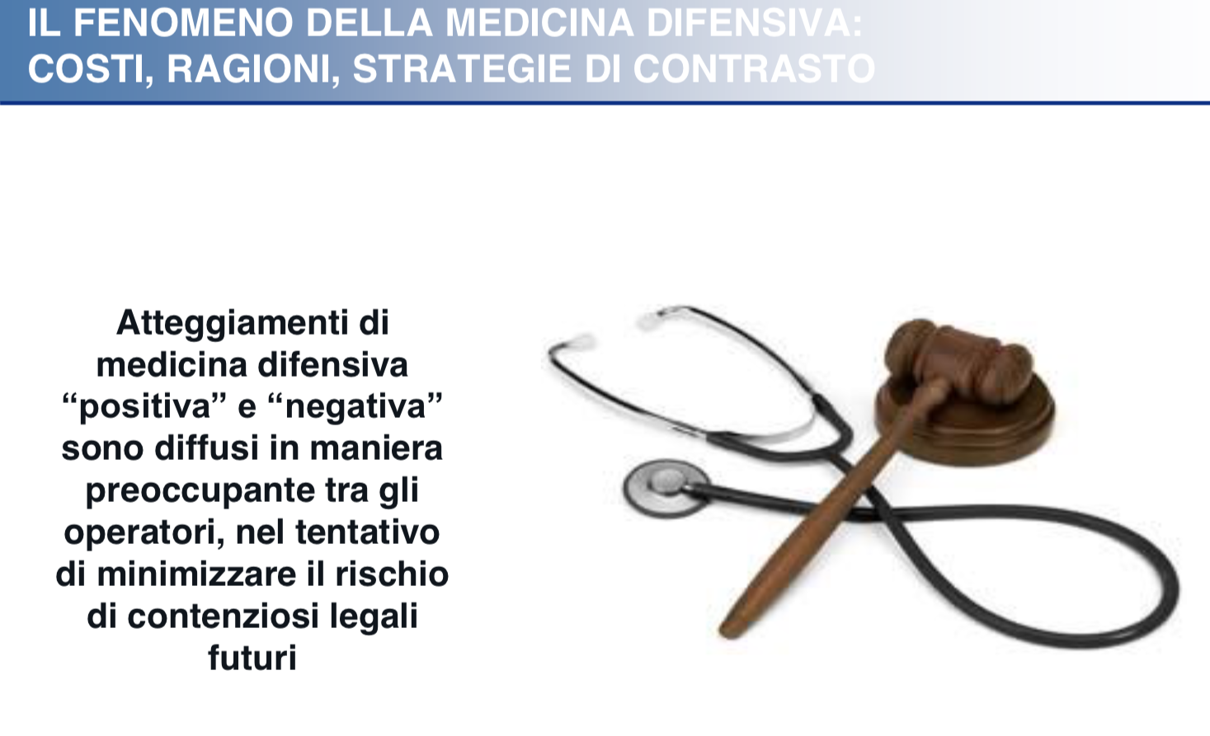

Slide 3
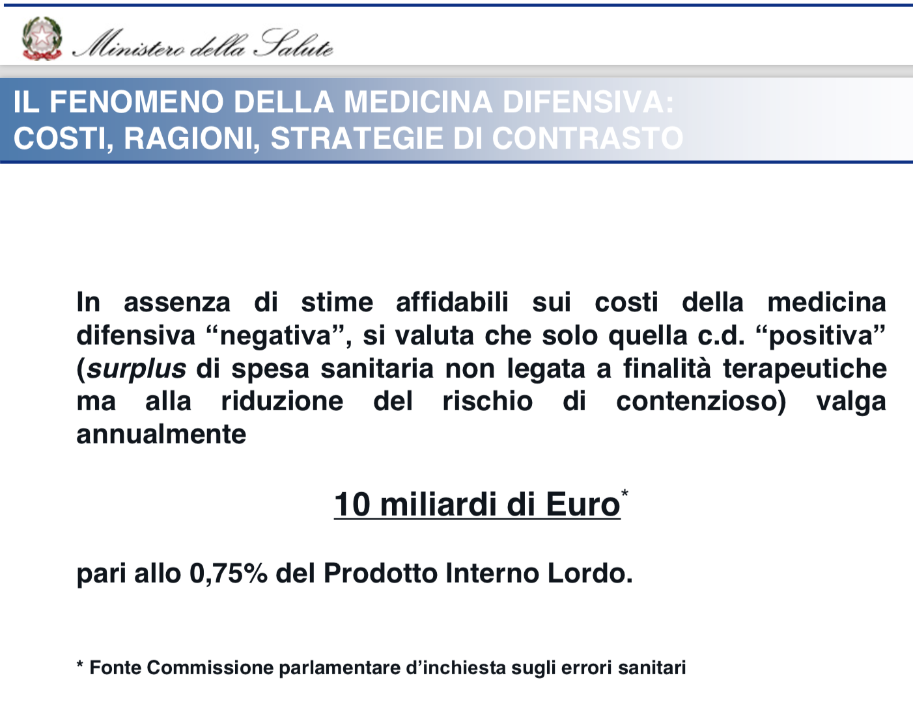

Slide 4
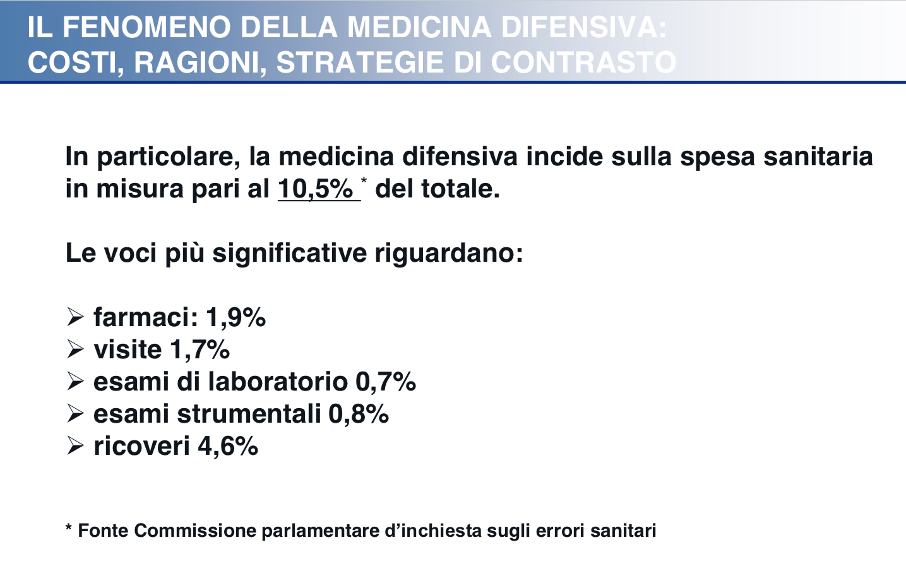

Slide 5
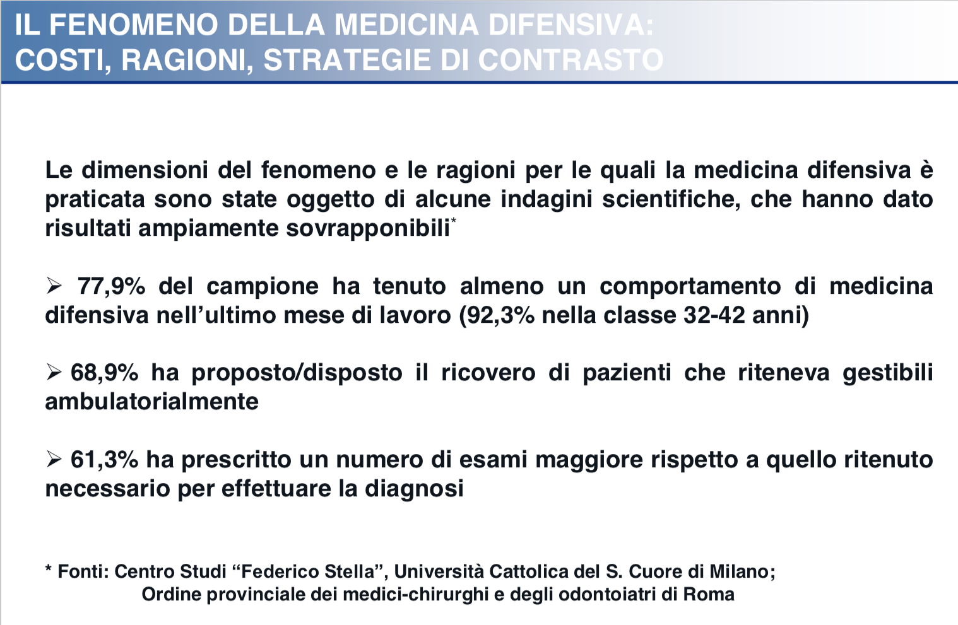

Slide 6
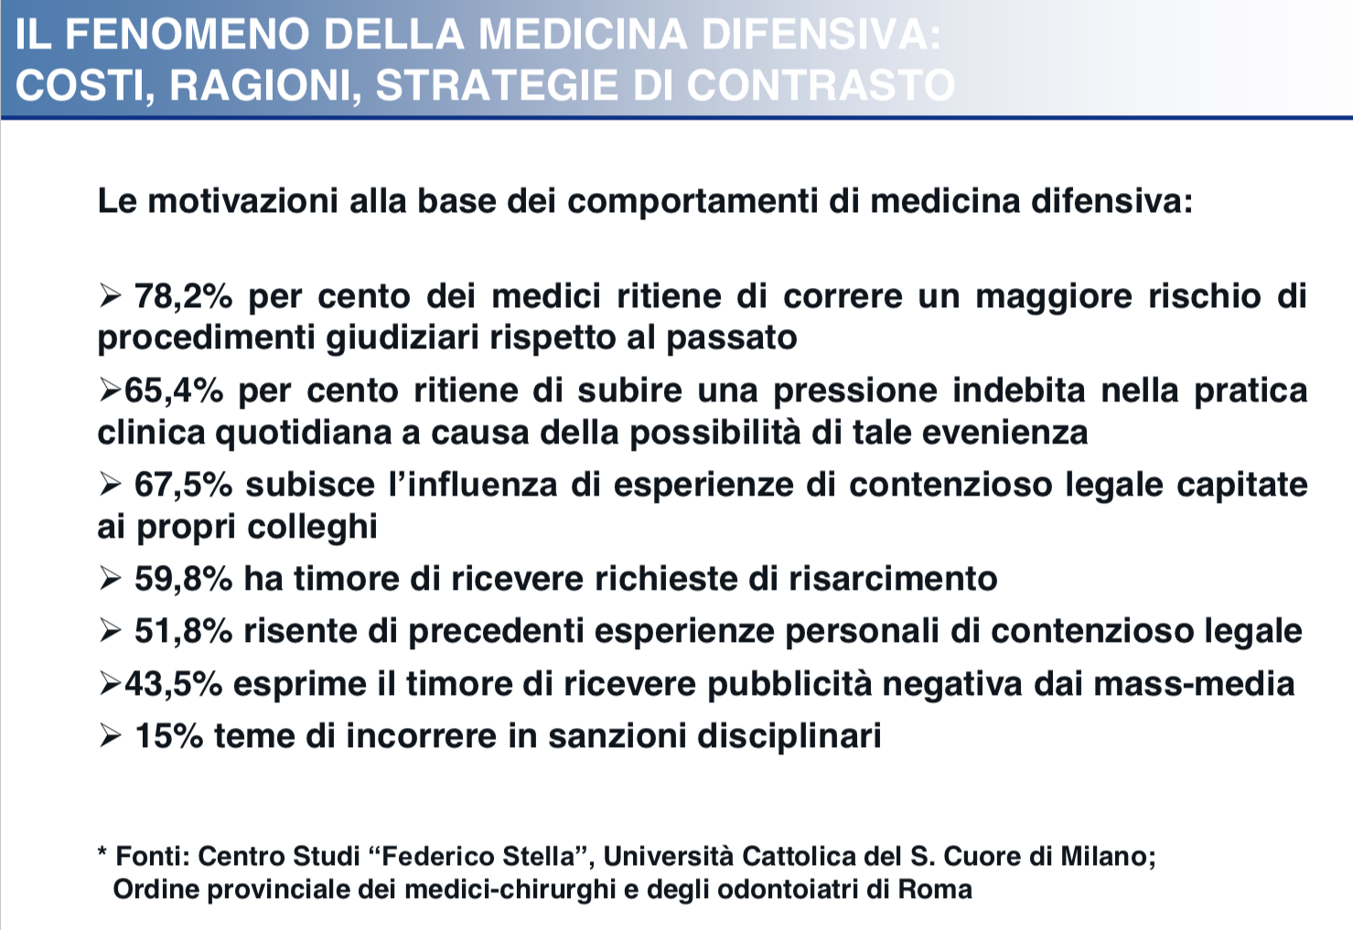

Slide 7
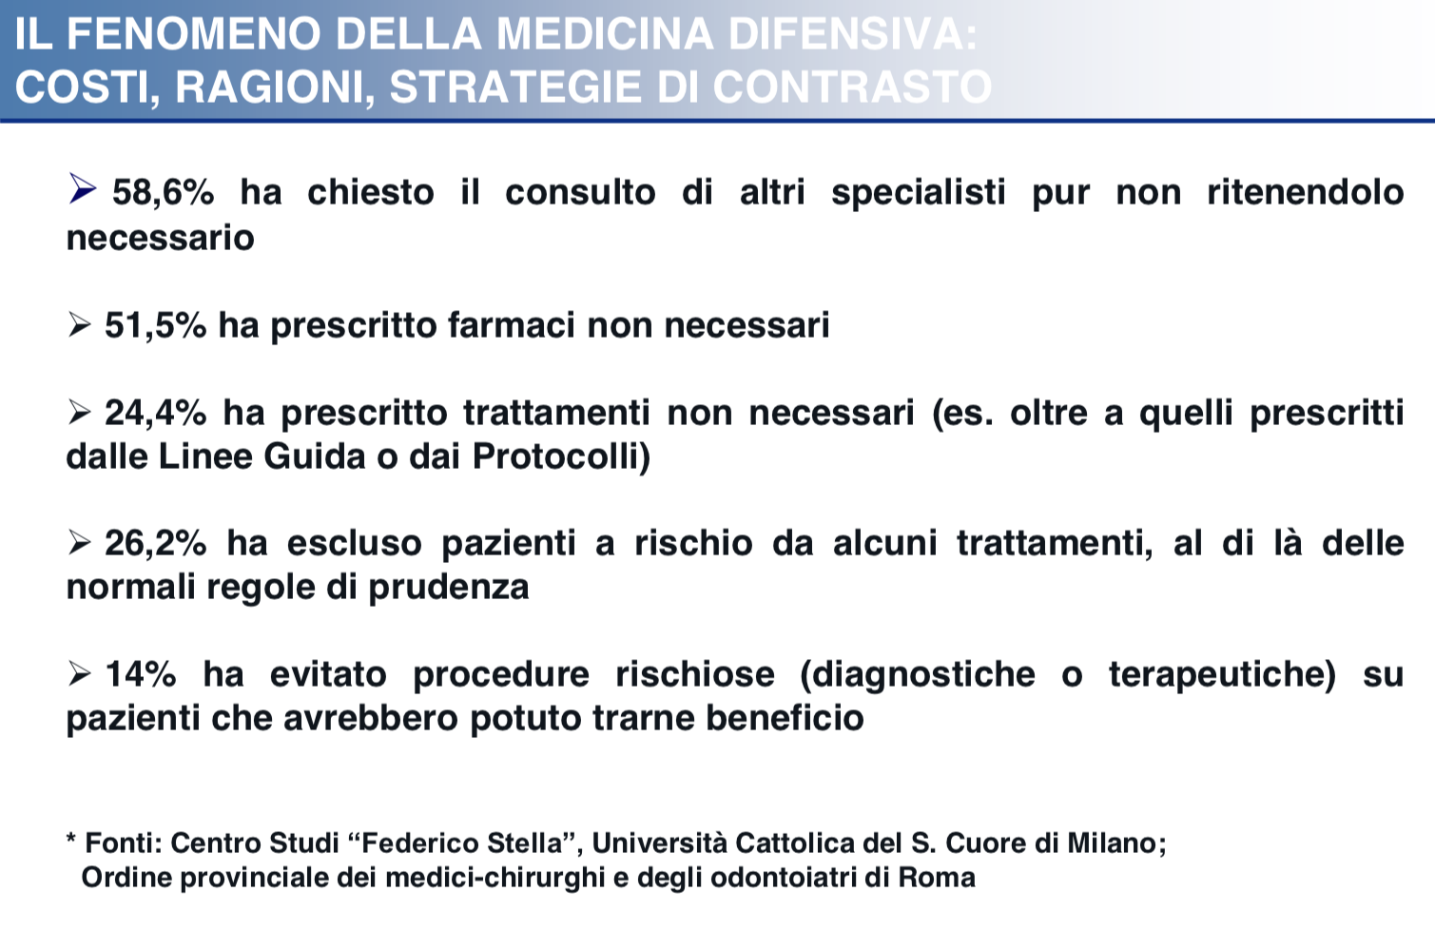

Slide 8
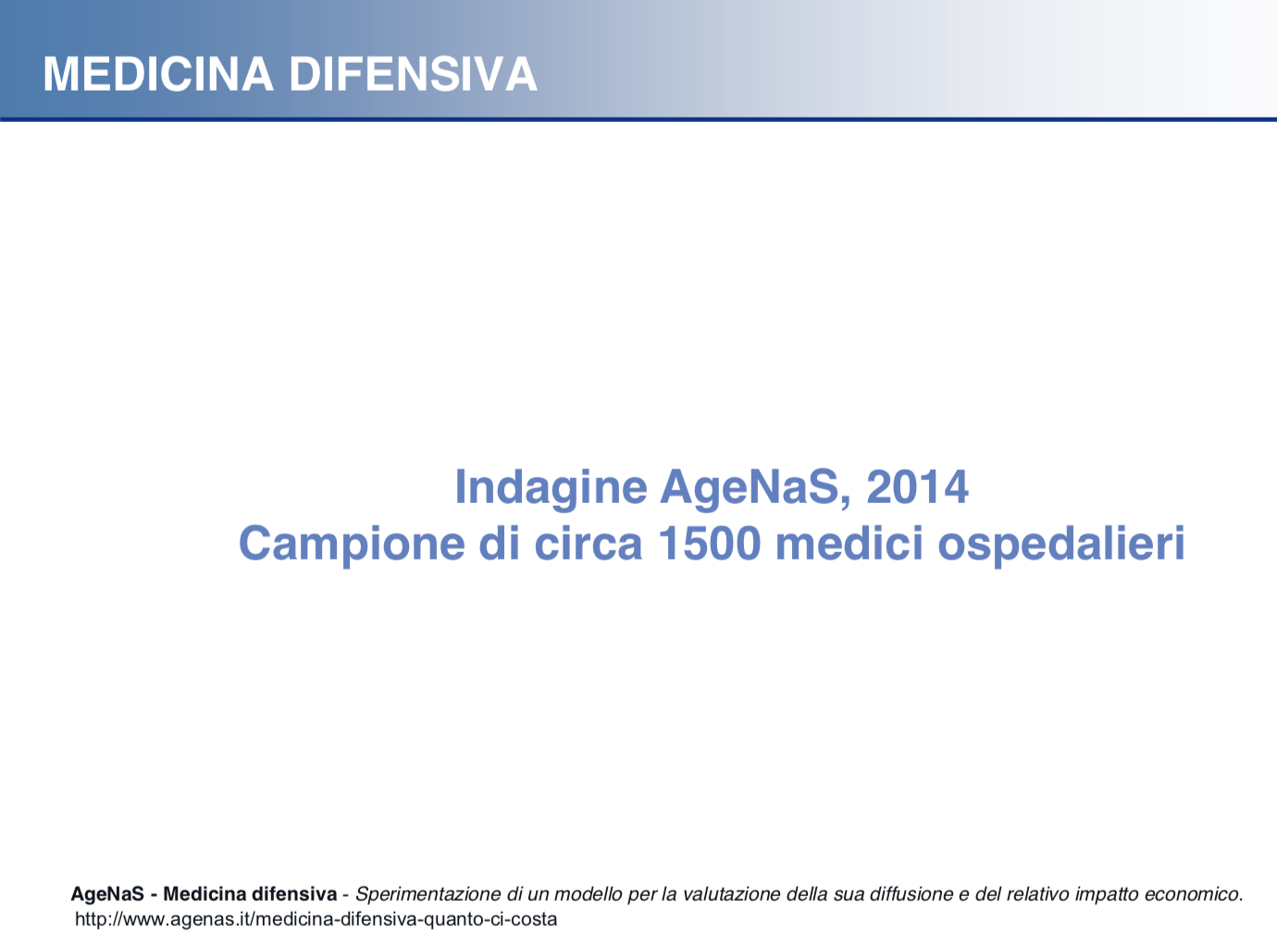

Slide 9
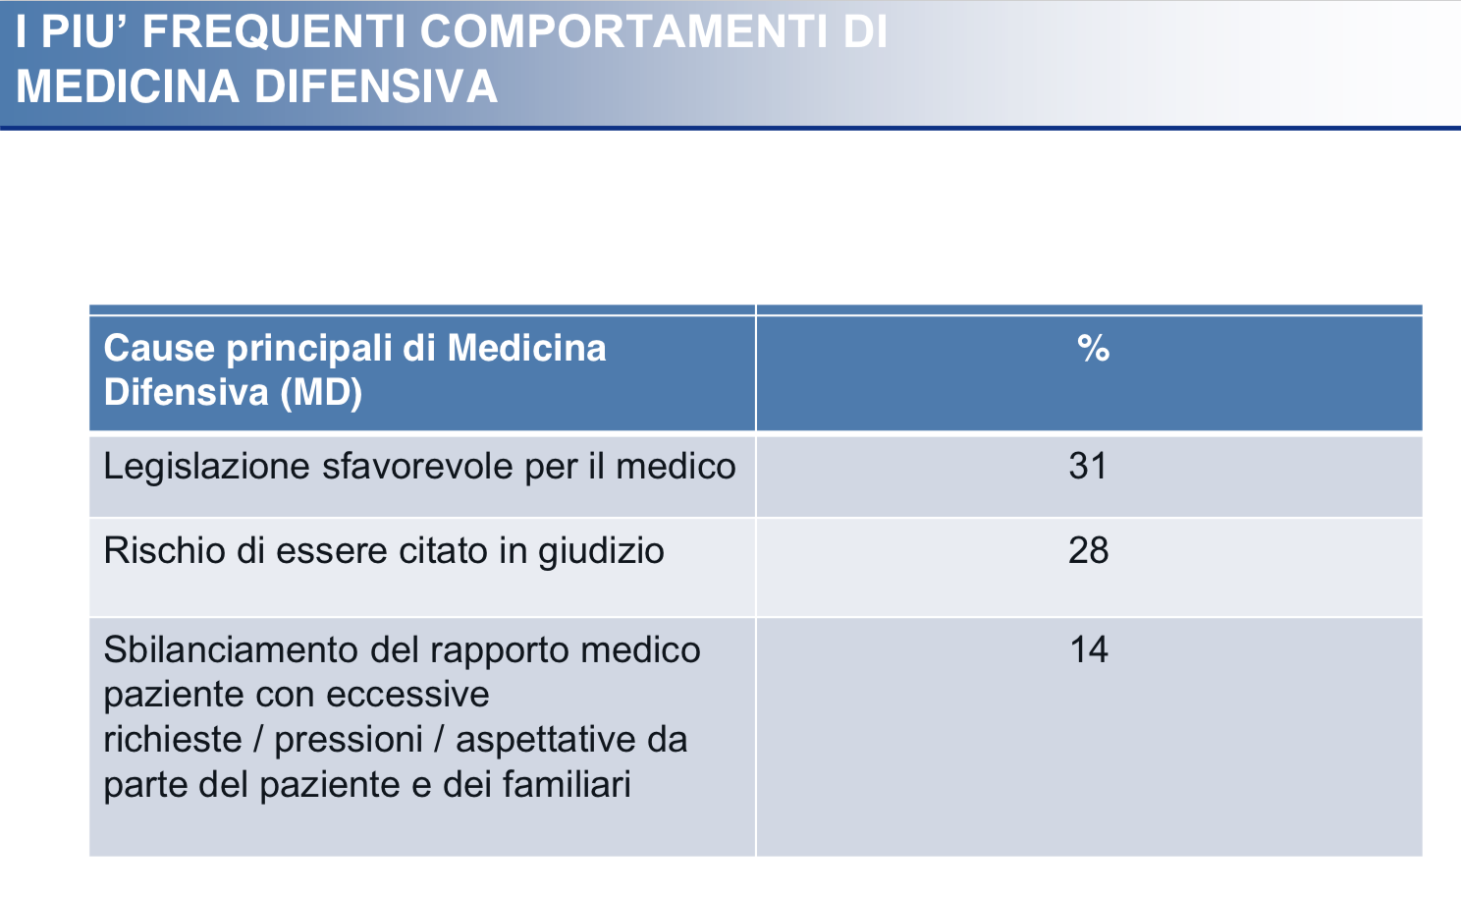

Slide 10
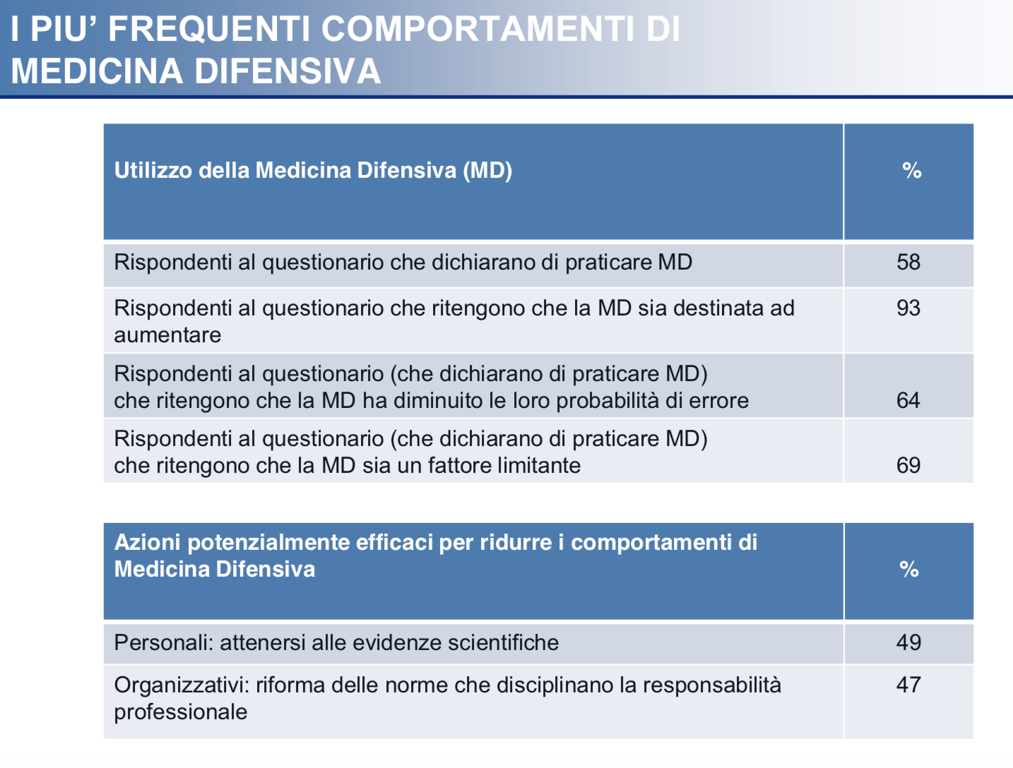

Slide 11
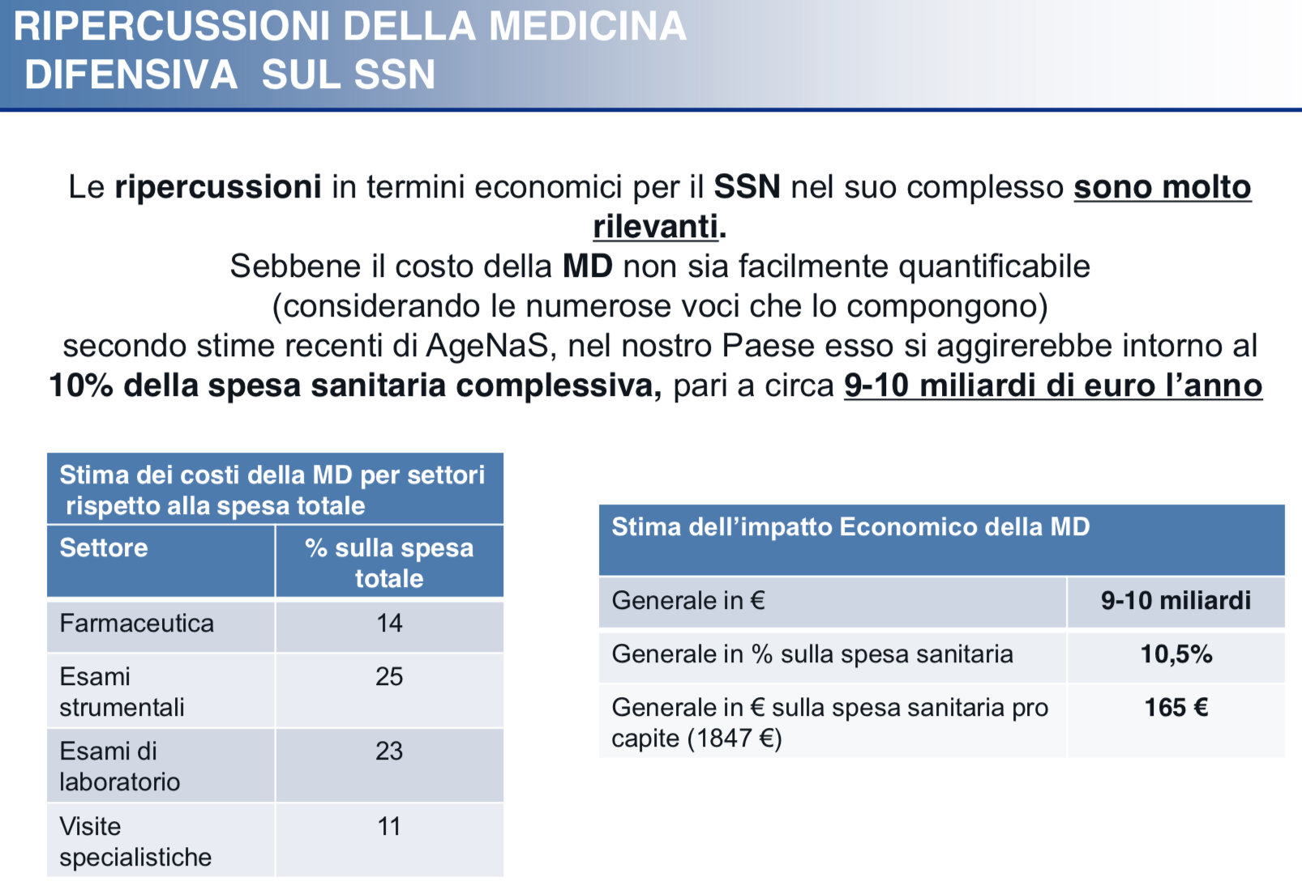

Slide 12
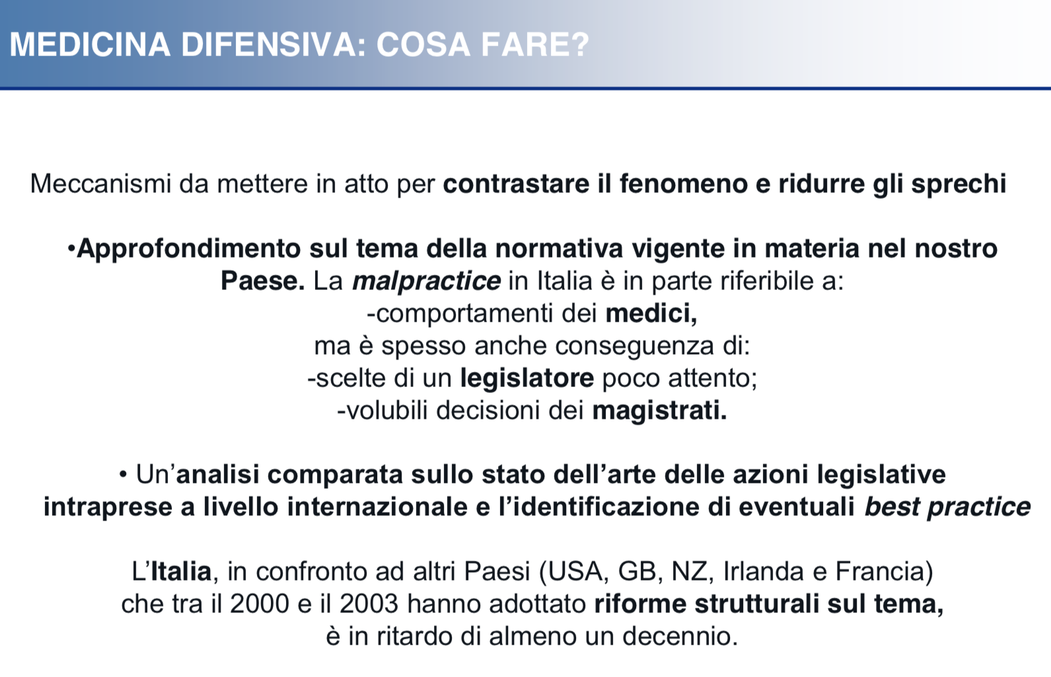

Slide 13
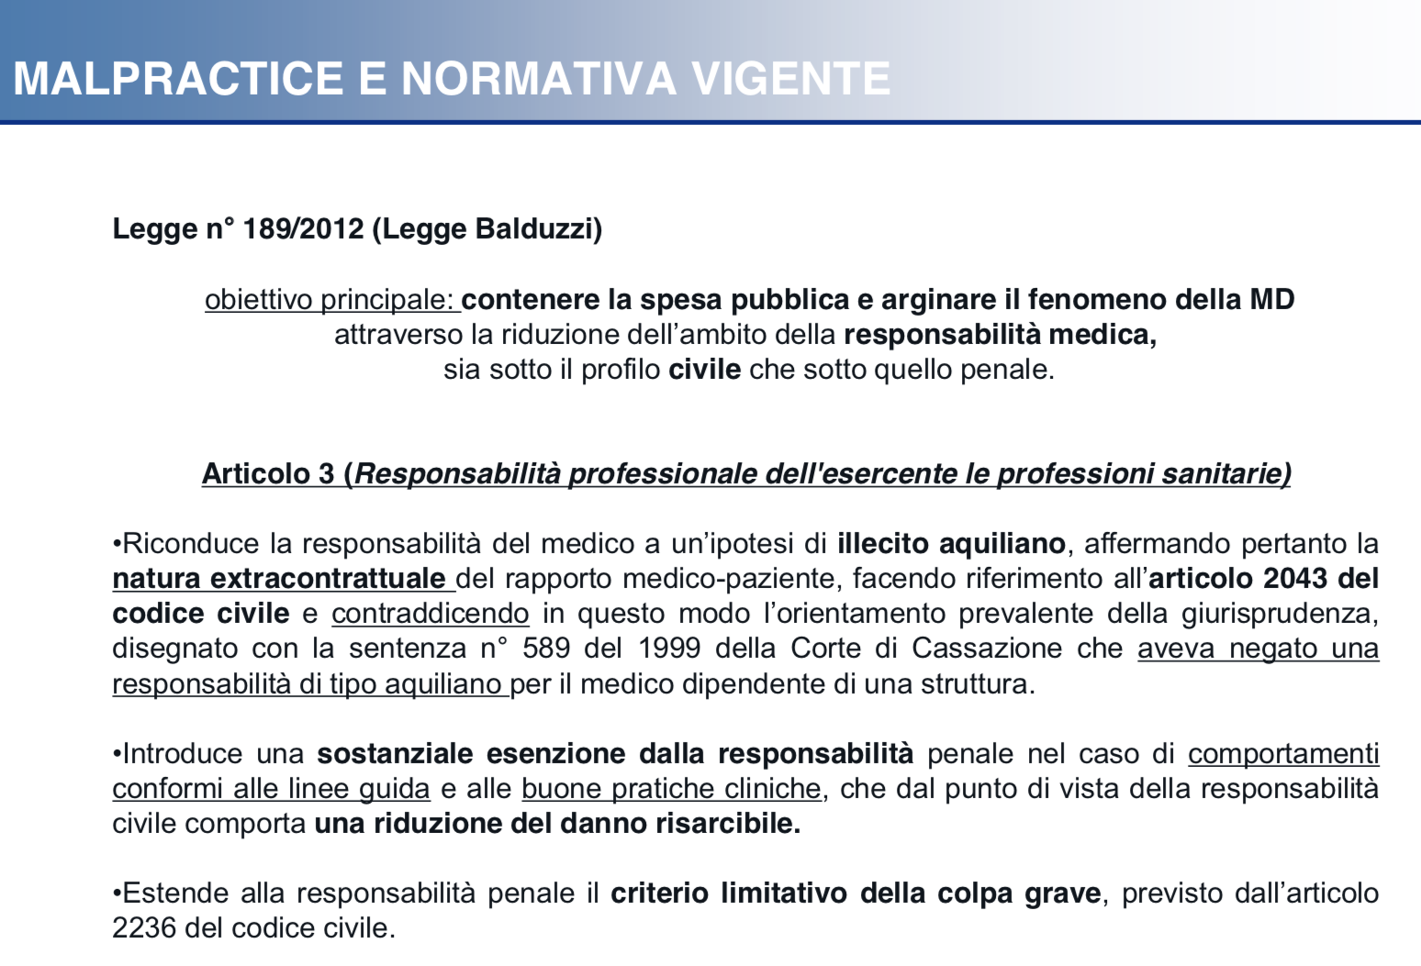

Slide 14
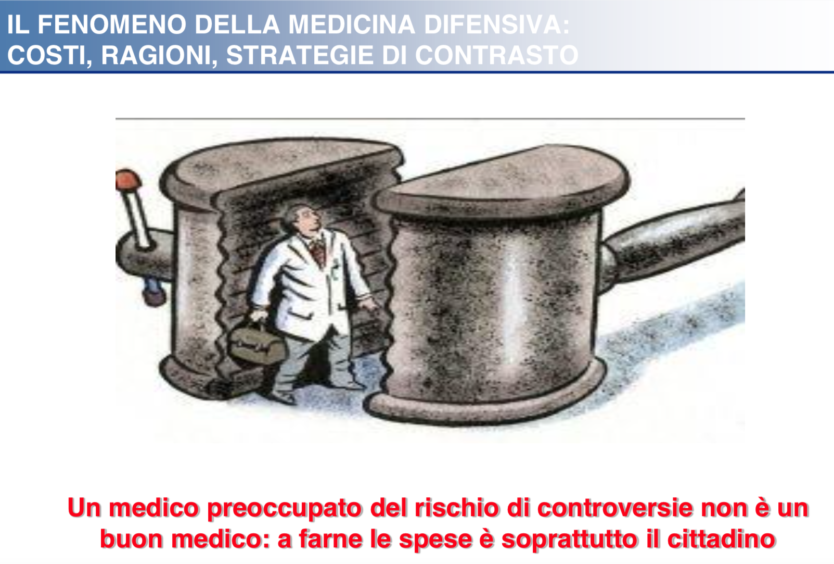

Slide 15
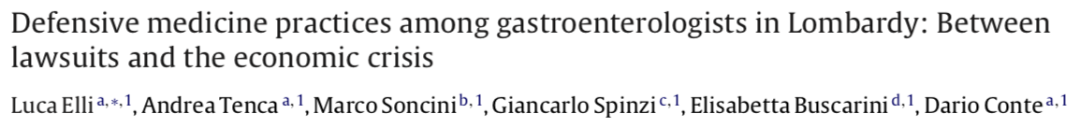
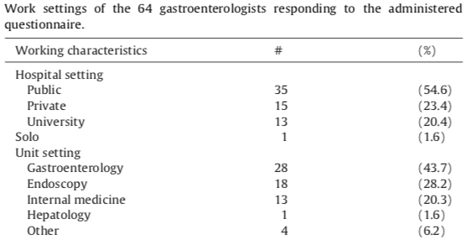
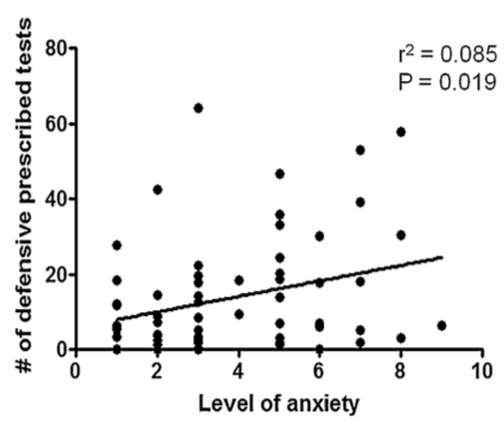
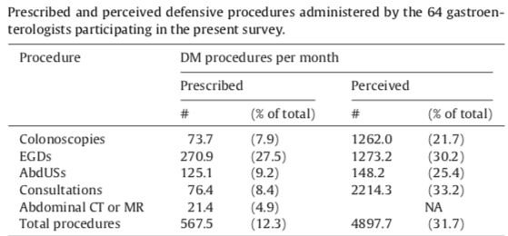

Slide 16
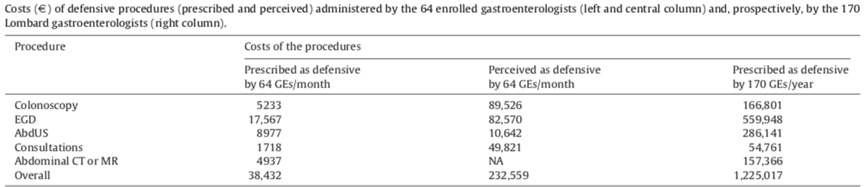
DM accounted for 11% monthly/costs of the procedures ordered by the respondents.
Prescribed plus Perceived: Total E 8.637.835
DM accounted for 11% monthly/costs of the procedures ordered by the respondents.

Slide 17

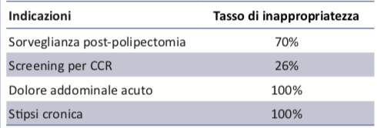
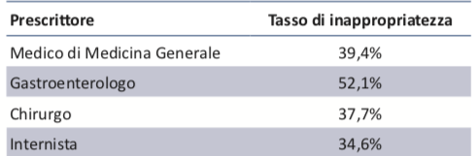

Slide 18
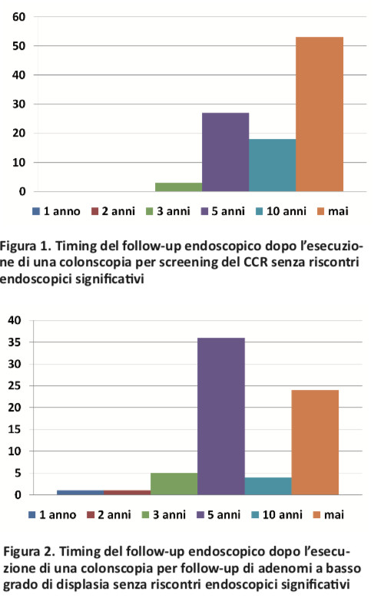

Slide 19
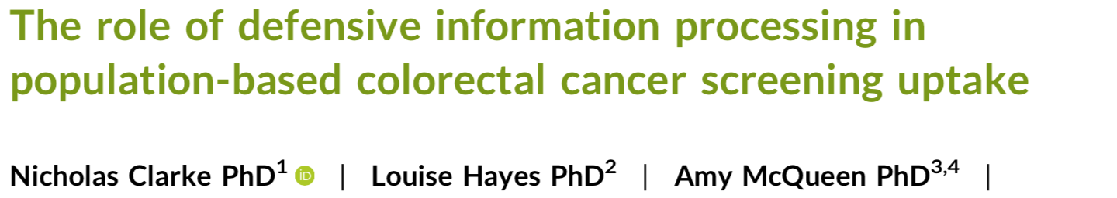

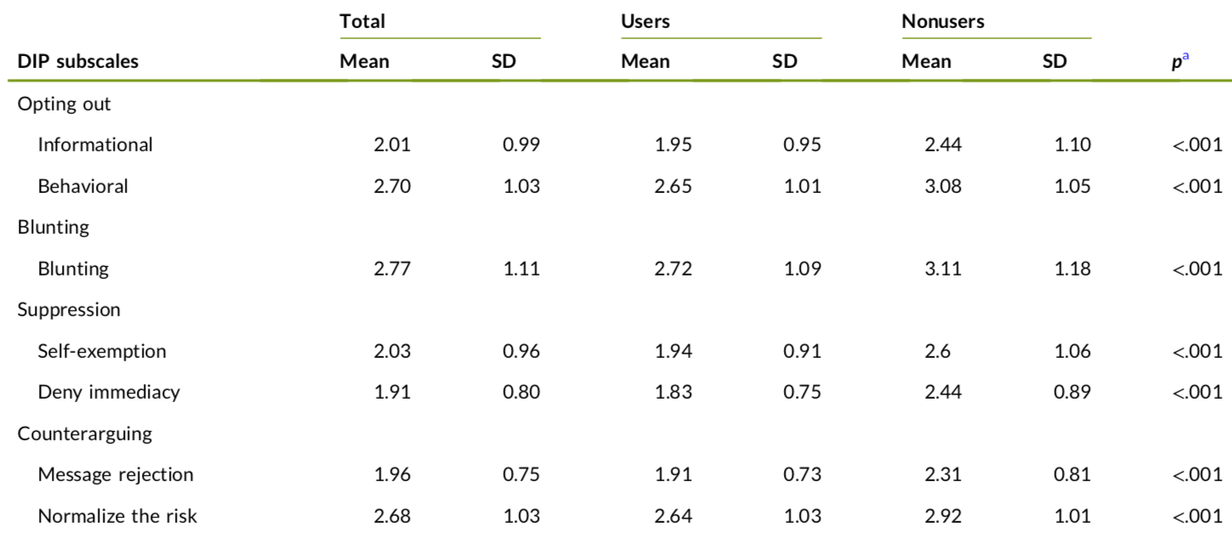

Slide 20
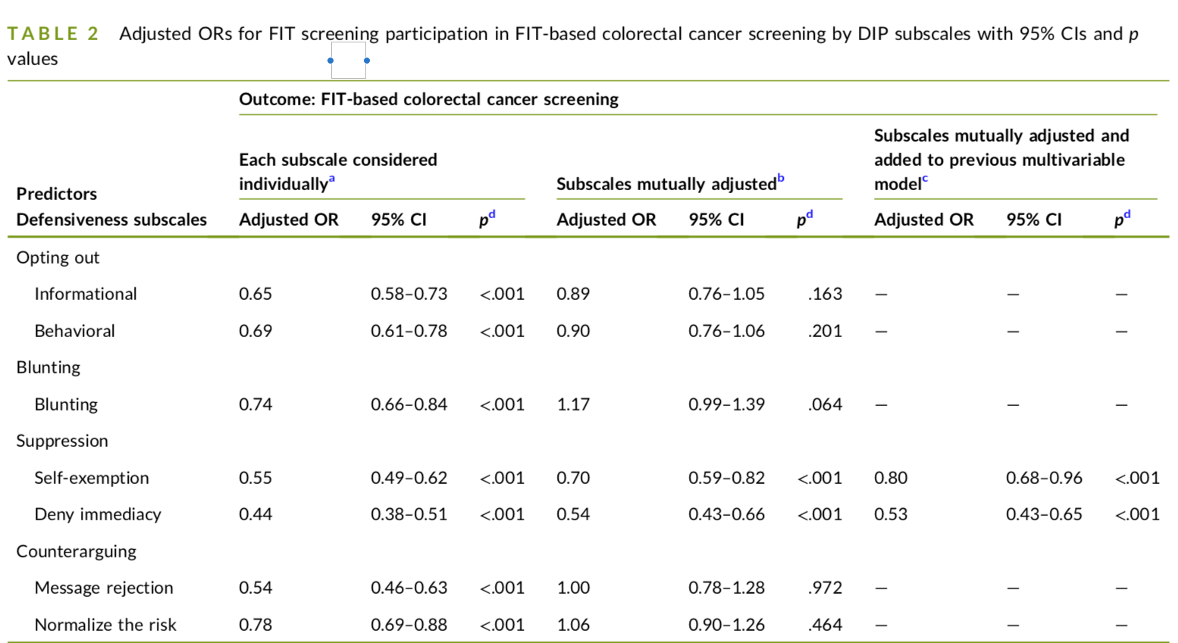
Adjusted ORs for FIT screening cancer screening by DIP subscales with 95% CIs and p

Slide 21
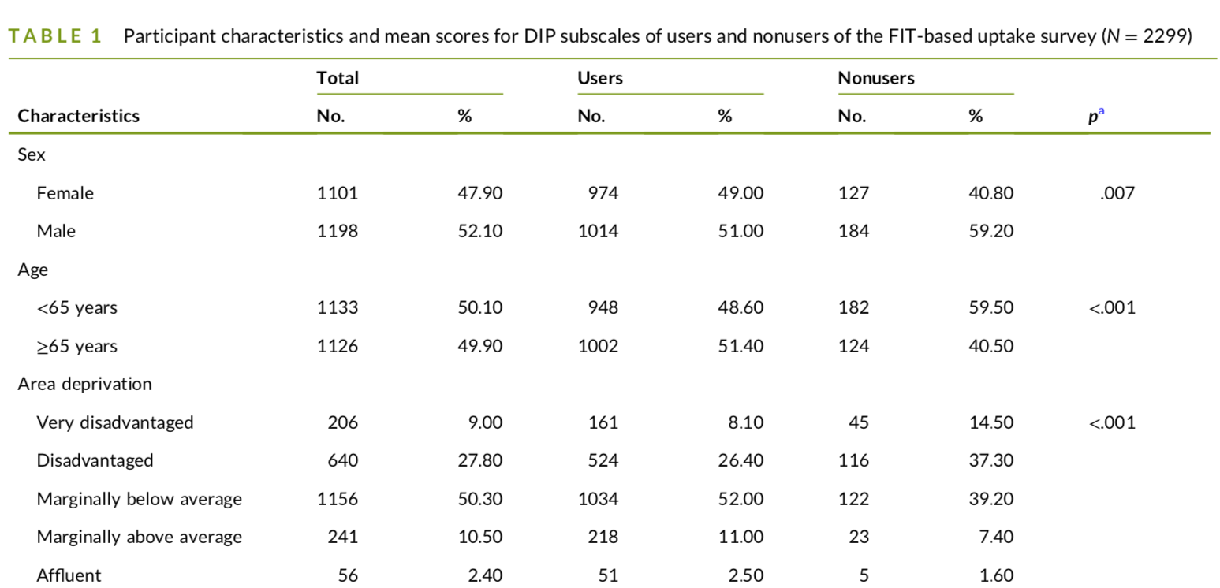
Notes:
all DIP subscales had a sta- tistically significant negative association with screening uptake; higher defensiveness scores were associated with lower odds of FIT‐ based screening participation. These results support previous find- ings and highlight the important influence of DIP on screening participation. Once other previously identified behavioral influences on uptake were taken into account, only the two subscales of the suppression domain remained statistically significant. Our results suggest that both kinds of suppression—self‐exemption (screening is not relevant or important for the individual) and denying immediacy (screening is not an immediate concern)—are independent influences on nonparticipation in FIT‐based screening.

Slide 22

Beverly Beth Green
Cancer. 2023;129:1156–1158
Defensive information processing (DIP) to avoid FIT for CRC screening.
DIP is a way of reducing the negative psychological effects of threats such as cancer and may influence health‐protective behaviors such as the completion of recommended cancer screening.
Suppression may be the most common defensive behavior when receiving an invitation in the mail to complete a FIT kit
A face‐to‐face clinician recommendation it’s effective to complete CRC screening. (trough electronic health record if patients don’t respond to mailed outreach)

Slide 23
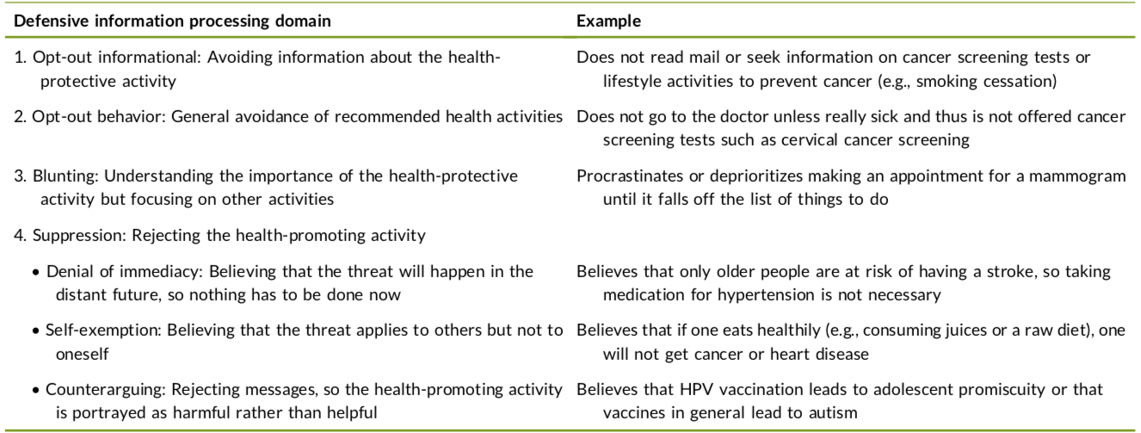
Beverly Beth Green
Cancer. 2023;129:1156–1158
Notes:
DIP likely plays an important role in other health‐protective behaviors, such as not receiving COVID‐19 vaccinations.1or HPV vaccination thet promote promiscue habits 2 For example, as part of a qualitative study, a nursing home director was asked why staff were not getting COVID‐19 vaccines. He said, “They feel they are invincible,” and either they will not get COVID‐19, or it will not be a problem if they do. “Invincibility” is an example of self‐ exemption DIP.13 A good example of counterarguing is believing that vaccines in general lead to autism despite strong evidence to the contrary.14 Misinformation (false information not created or shared with intent of harm) or disinformation (false information shared for malfeasant purposes) often fuels counterarguing DIP.
DIP is also likely related to contextual factors, social de- terminants of health, and structural racism. For example, anyone experiencing food or housing insecurity may not be able to prioritize self‐protective behaviors such as participation in screening programs, and this may manifest as opting out or blunting. Furthermore, a lack of health insurance, differential coverage for screening tests and follow‐up, and the financial consequences of completing cancer screening might influence DIP behaviors. The role of defensive information processing in population‐based colorectal cancer screening uptake Other recent studies have found associations between defen- siveness and nonadherence to other types of cancer screening. In Norway (where population‐based mammography screening pro- grams exist), a survey (using a convenience sample) examining how psychological factors influence defensive avoidance of breast screening reported that women with a greater fear of breast cancer were more likely to engage in defensive processing to rationalize why they did not need mammography screening

Slide 24
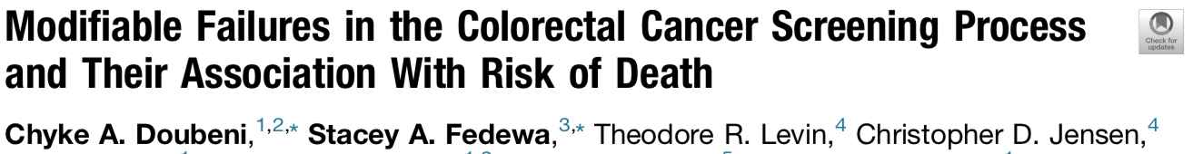
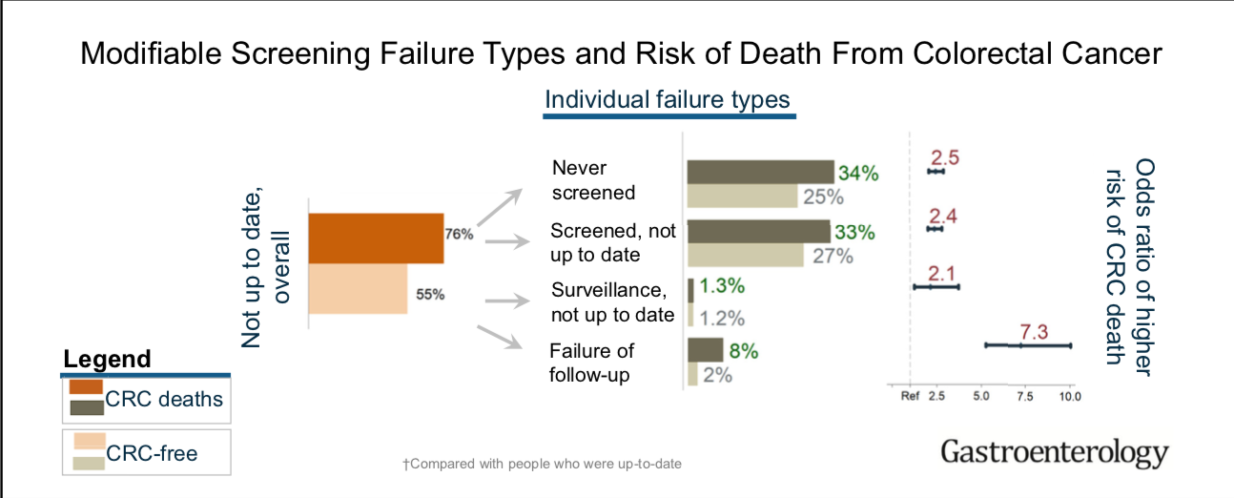
Being up to date < risk of dying of CRC by more than 60%.
The risk of death from CRC was > 2-fold higher in people who had failed to screen
and about 7-fold higher in those with failure of follow-up.

Slide 25
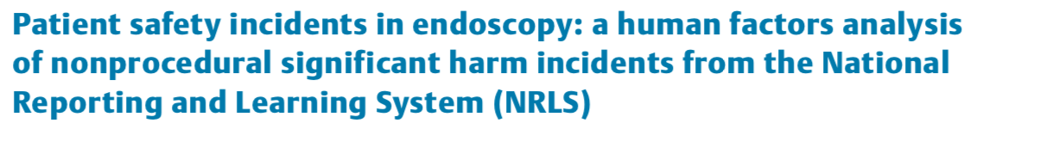
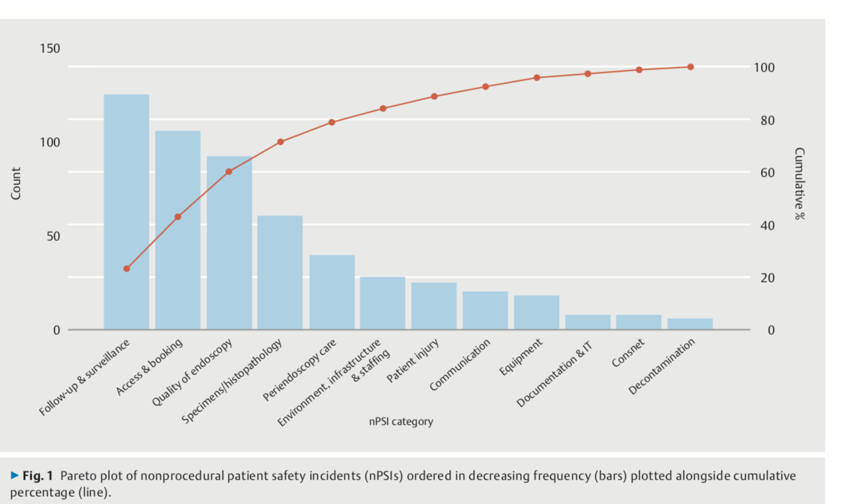
85%
65%
18%
2%

Slide 26

85%
65%
18%
2%

